Slide 1
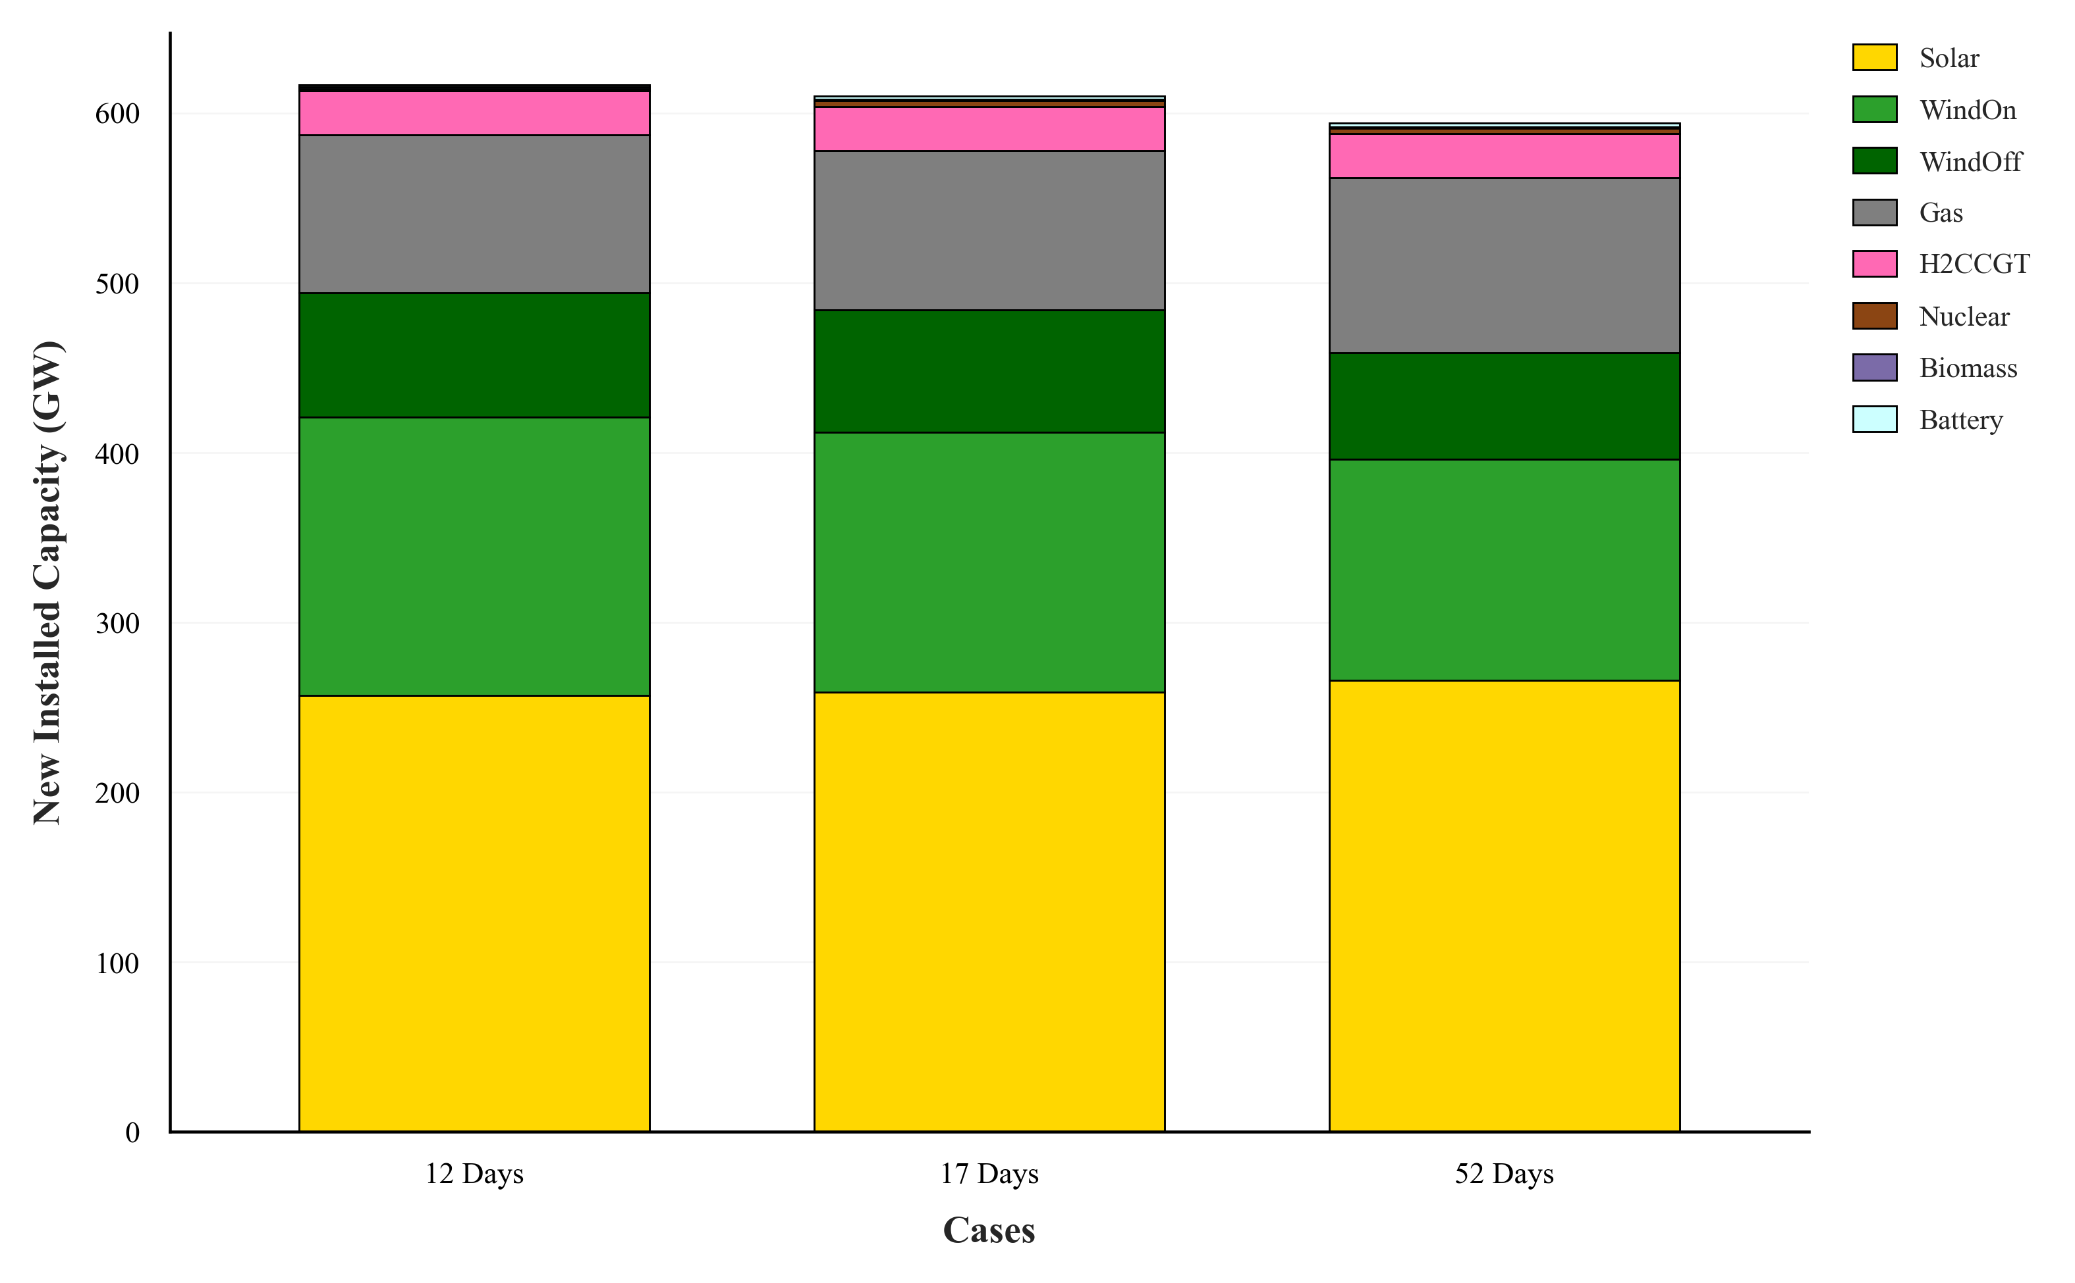
a
b
Cost Breakdown (b €) | 12 Days | 17 Days | 52 Days
Capital cost | 277 | 279 | 281
Fixed O&M Cost | 154 | 154 | 153
Variable O&M Cost | 11 | 11.2 | 11
Fuel Cost | 160 | 163 | 161
Carbon Cost | 81.5 | 81.5 | 81.5
Curtailment Cost | 2.23 | 2.12 | 2.21

